Slide 1

Wayfair Seo Group Project
By George Barahona

Slide 2
Wayfair Profile
Industry
E-Commerce
Service
Home Improvement Furniture & Appliances
Online Presence
Search Traffic:15.5M
Paid Search Traffic: 1.5M
Time Spent: 13 Minutes
Authority Score:79
USA 64% of Market Share
Notes:
GB
Wayfair is in the e-commerce industry
that serve home improvement furniture & appliances
There online presence: has ..
Authority Score is a compound metric that grades the overall quality of a website

Slide 3
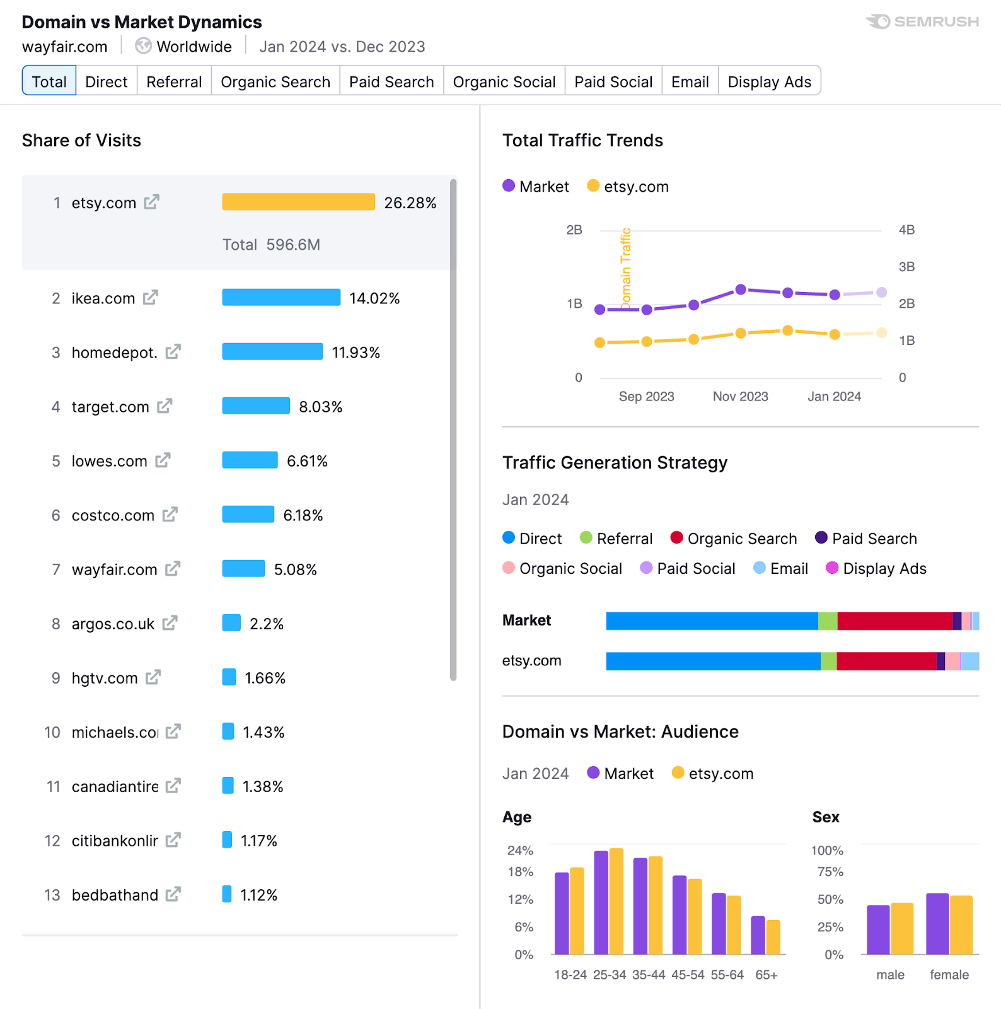
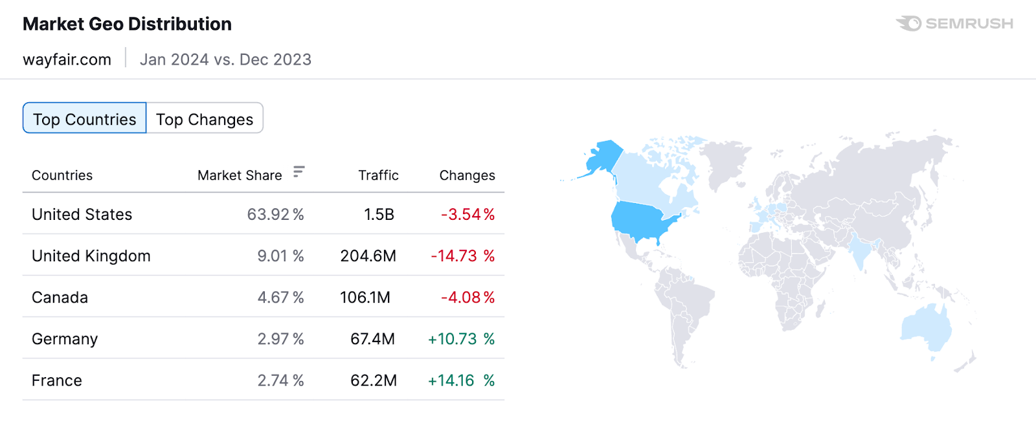
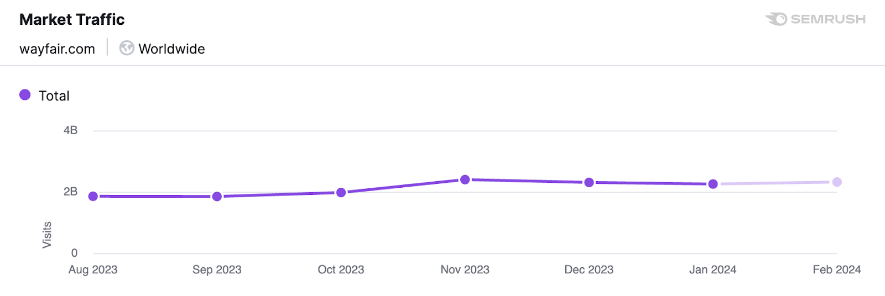
Marketing Metrics
Notes:
VB
on the left you see where wayfair ranks with there competitors

Slide 4
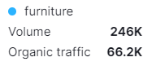
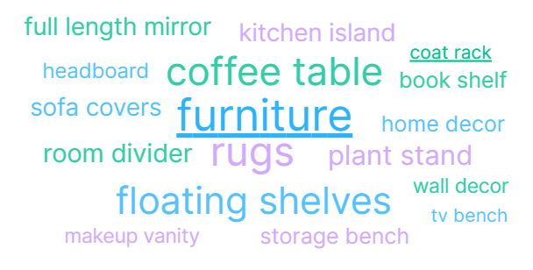
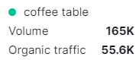
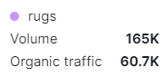
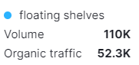
Marketing Metrics
Notes:
GB
Keyword search

Slide 5


Initial website audit

Slide 6
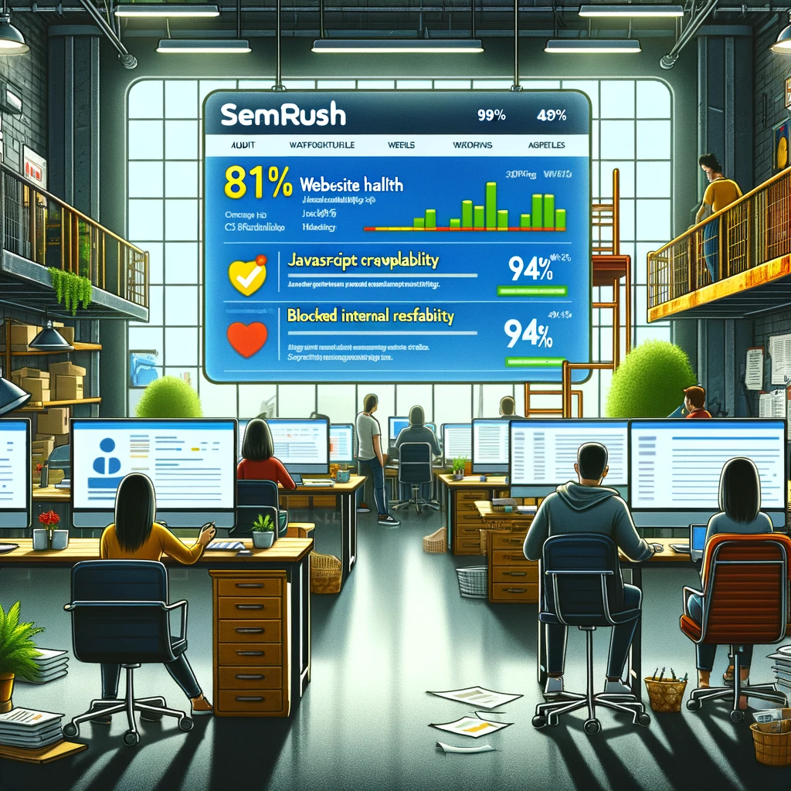
Wayfair Website Audit (SEMrush)
Wayfair.com website health based on site performance, crawlability and indexability is relatively good at 81%.
Crawlability is 94%.
Site Performance related issues are 20% of Top Issues:
JavaScript and CSS files excees 2MB reducing page load time, therefore causing lower search engine ranking: it is recommended to reduce the size of transfer file.
Crawlability related issues are 21% of Top Issues:
Blocked Internal resources like CSS, JavaScript, Image files are blocked from crawling or ”disallowed” that are preventing search engines from accessing them, as a result, properly rendering and indexing the web pages. This in return may lead to lower rankings. Is is recommended to unblock the resource, simply update robot.txt file.
Notes:
MM

Slide 7
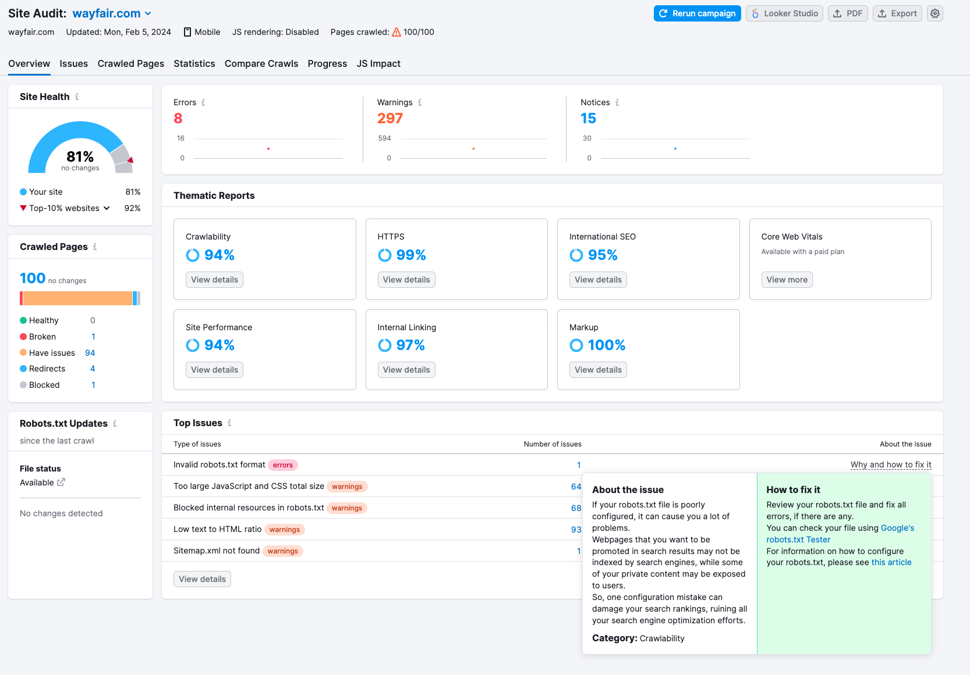
Wayfair Website Audit (cont.)
JavaScript : used to create interaction between webpage and user
CSS: used to design the webpage for better layout for the user
https://www.educba.com/css-vs-javascript/
Ikea Website Audit - competitor
Website health based on site performance, crawlability and indexability is at 79%.
Ikea.com has mostly problems with indexability due to images without attributes, totaling 62% of Top Issues.
Crawlability for Ikea.com is at 100%.
Notes:
MM

Slide 8

SEO Website Objectives

Slide 9
SWOT Analysis – Wayfair LLC
Strength
Wayfair’s strength is focused on their competitive pricing and marketing strategy.
Weakness
Wayfair seems to struggle with cash flow and their trust in third party suppliers
opportunity
Luckily for Wayfair, e-commerce has continually been a positive trend.
Threats
Major corporations in the furniture and home goods industry are a huge threat to Wayfair
Notes:
EG

Slide 10
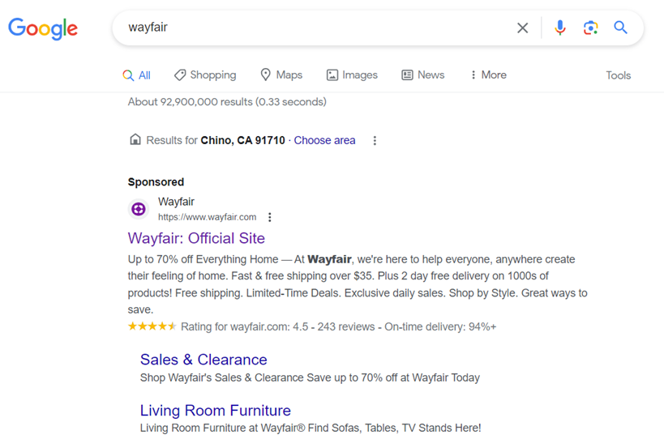
SEO OBJECTIVES
1. Business relevant SEO Objectives include:
Establish themselves - trustworthy furniture and home goods provider.
Wayfair is an established brand: recognizable logo
Competitive Pricing & Deals – Wayfair uses deals and use Sales & Clearance
Notes:
EG

Slide 11
SEO OBJECTIVES CONT.
1. Business relevant SEO Objectives include:
d. Financing for those customers who are willing to make larger purchases but need more time to pay.
e. Vast selection of goods.
f. Signup option – cookies, loyal members, email marketing etc.
Notes:
EG

Slide 12
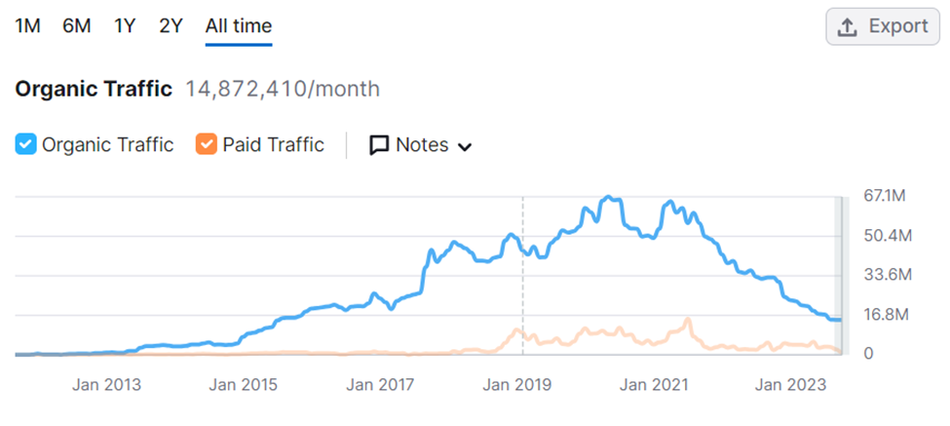
SEO OBJECTIVES CONT.
1. Focus on:
a. Driving Traffic back to the site.
Notes:
EG

Slide 13
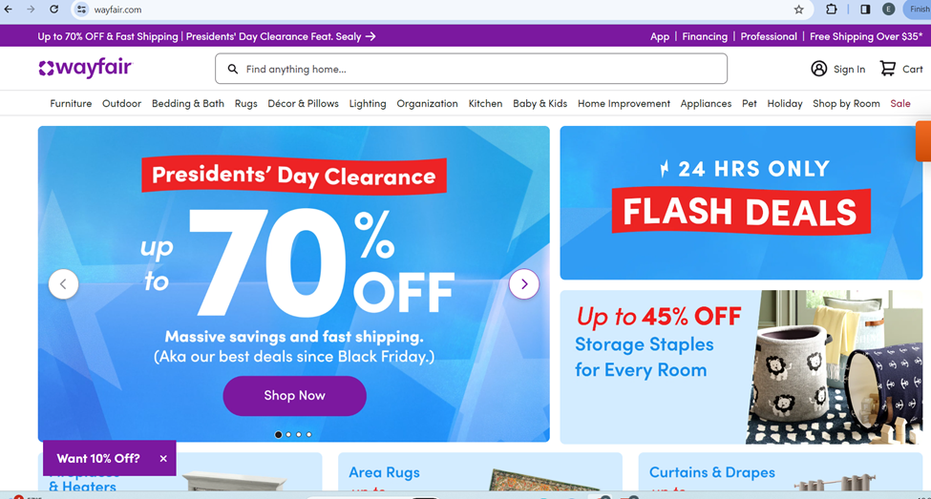
SEO OBJECTIVES CONT.
1. Focus on:
b. Ease of delivery. Showcase that they can be as easy and reliable a company as a competitor like Amazon.
c. Competitive pricing and excellent quality of goods to keep your customer base happy.
Notes:
EG

Slide 14
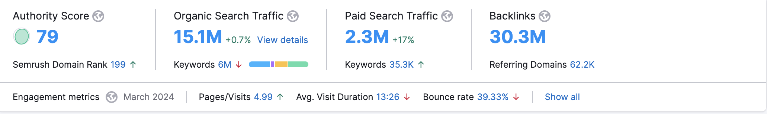
Domain Overview
Notes:
SA

Slide 15
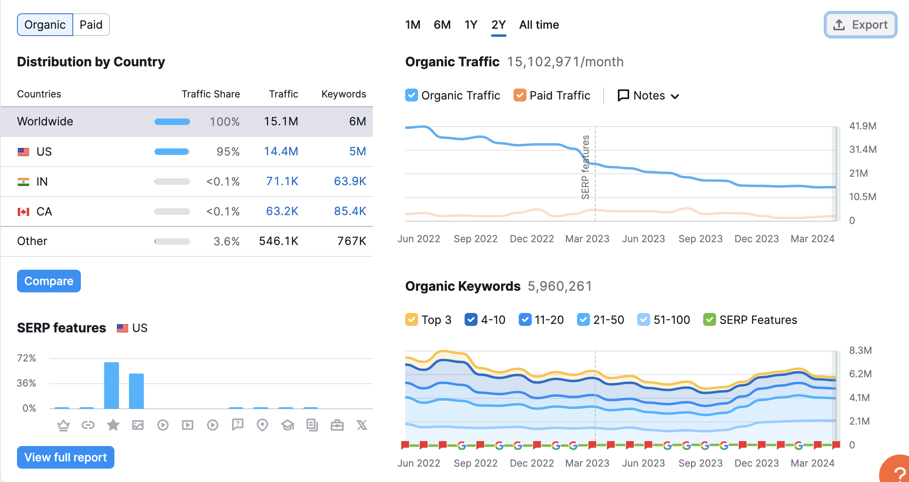
Notes:
SA

Slide 16
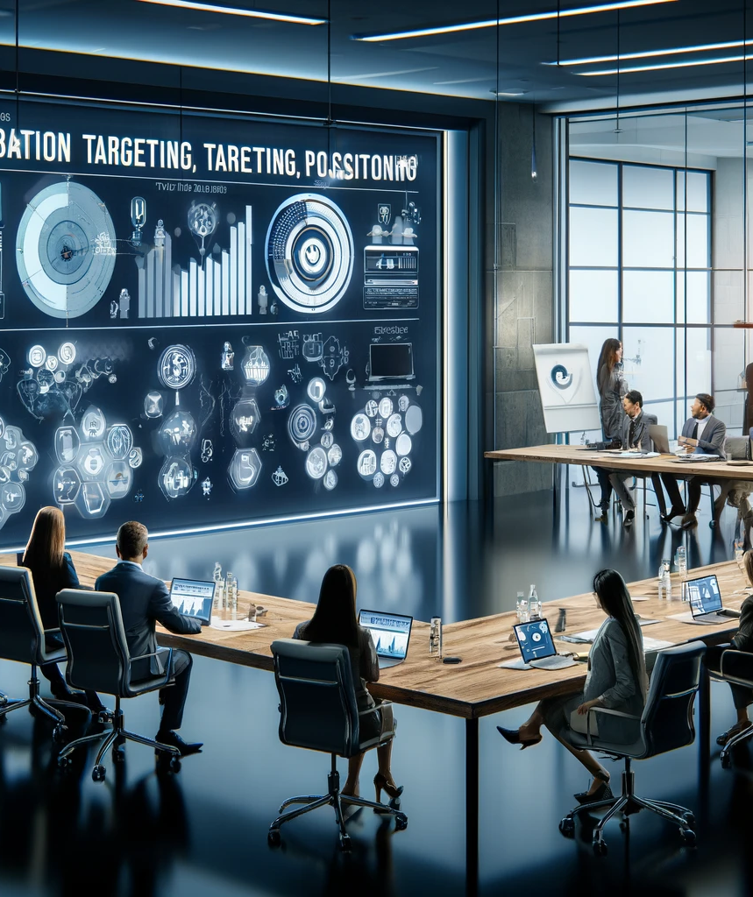
Segmentation, targeting & positioning

Slide 17
STP Campaign
Demographic Profile
General: Adults 25-54
Scope: 35-44
Income: Middle – Upper Middle
Education: Mixed
Geographic: Urban & Suburban
Target Audience: Consumers seeking home furnishings & decor solutions.
Priorities: Affordability, and variety of products.
Lifestyle Activities: Home improvement, browsing decor, and DIY projects.
Psychographic Profile
Positioning
Strategic Positioning: A online home goods retailer, flexibility and convenience for customers.
Digital Innovation: Wayfair revolutionizes the furniture shopping experience, no brick-and-mortar stores.
Future Plan: Continuous growth and innovation in the home goods digital market.
Notes:
GB
P- emphasizing unparalleled flexibility and convenience for customers.

Slide 18
Search Intent
Needs
Wants
Find a particular product (navigational)
Access information (informational)
Make a purchase (transactional)
Wide range of home furniture
Convenient online shopping
Affordable ways to shop (coupons, discounts).
Product reviews and product info
Employment opportunities at Wayfair
Notes:
VB

Slide 19
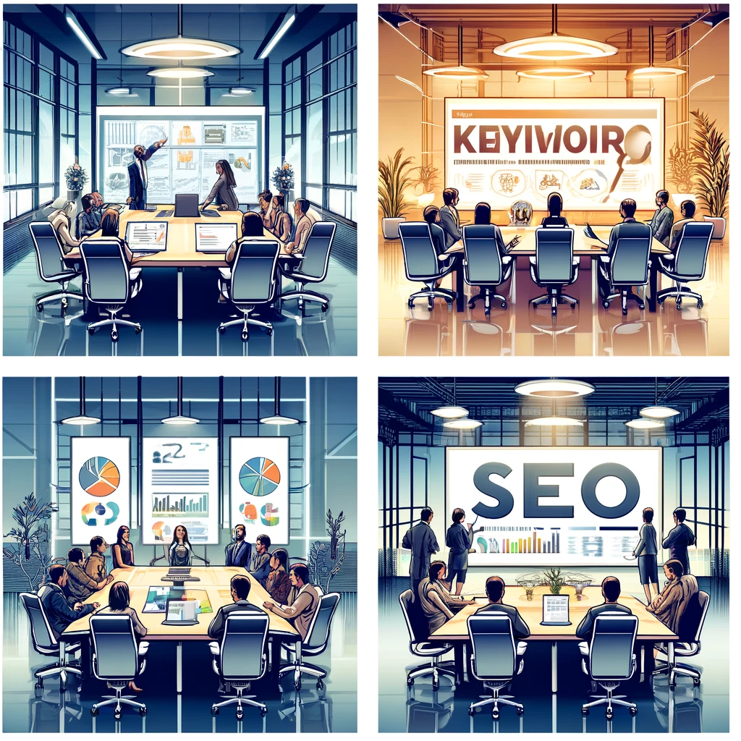
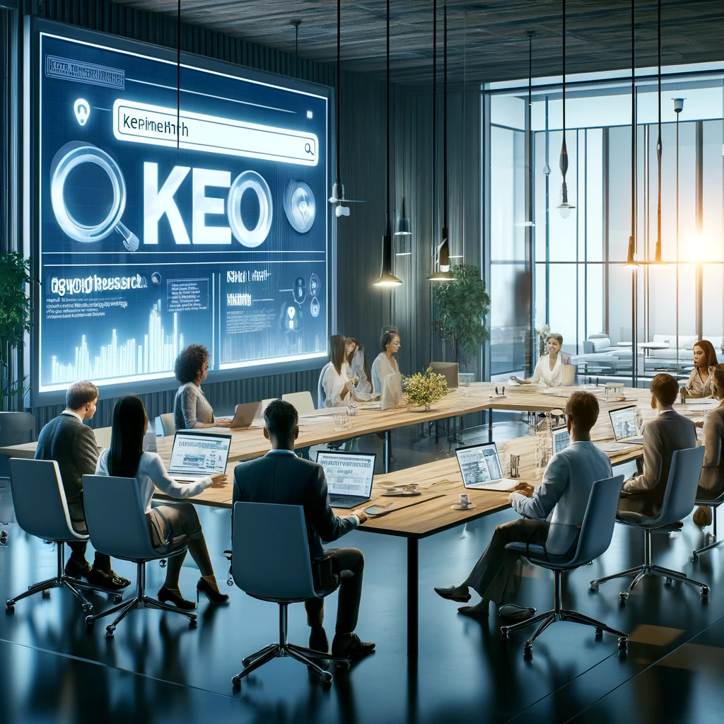
Keyword research

Slide 20
Keyword Research
Hidden value
Overlooked Opportunities, Valuable Backlinks, & Untapped Niches
Search Intent
Enhancing relevance & Consumer intentions
Monthly volume
Potential traffic & Creates content strategy opportunities
Keyword difficulty
Competitiveness of keywords
&
Measurement of Growth
Notes:
GB
When working with keywords we looked for keywords that had hidden value that provided opportunities for us, and keywords that have a consumer transcational intention
Most important keyword traffic that had high monthly coulme and low keyword difficulty, a low keyword difficulty provides a niche and mesaurment of groeth for those keywords

Slide 21
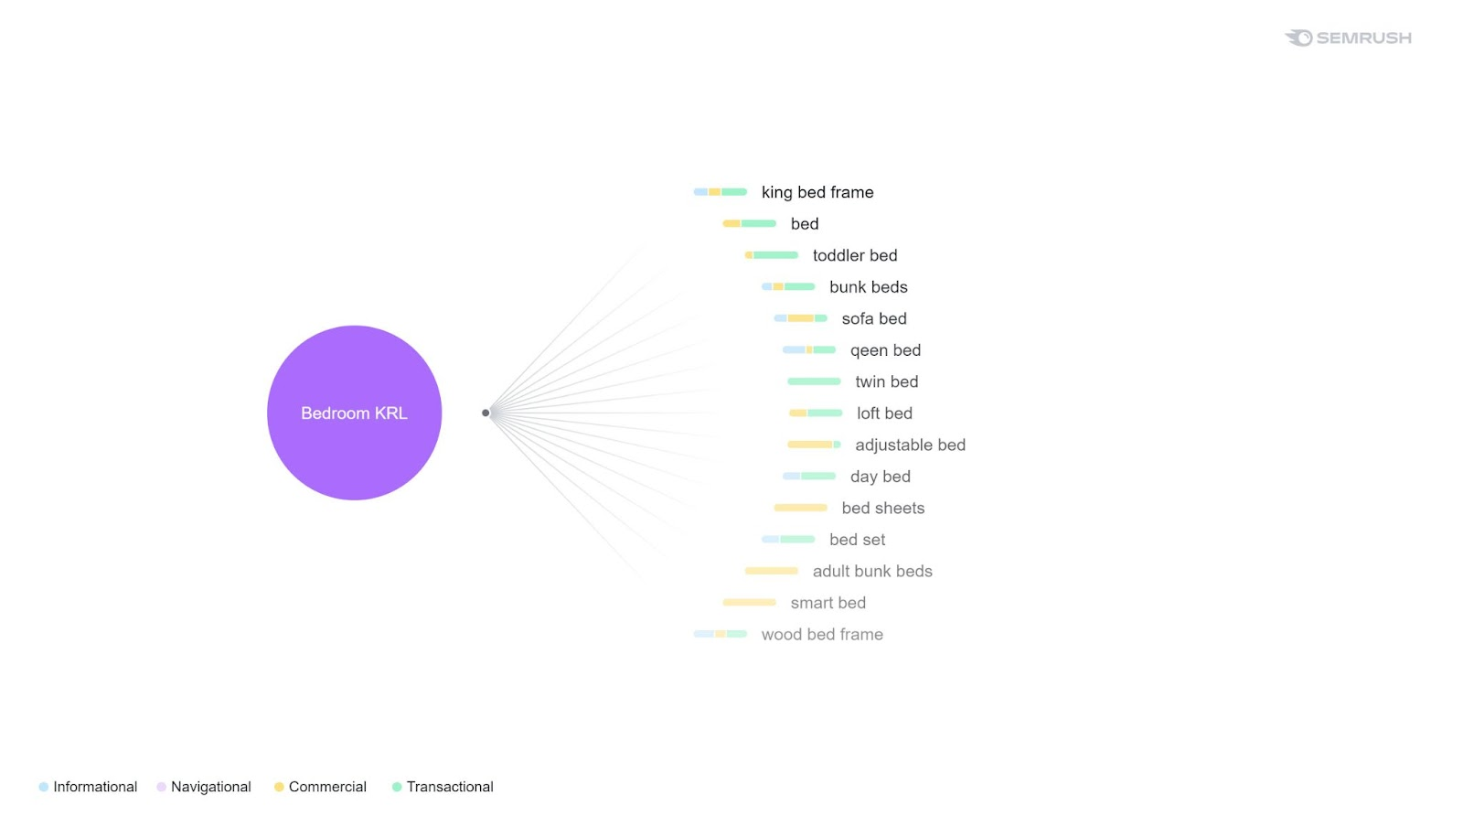
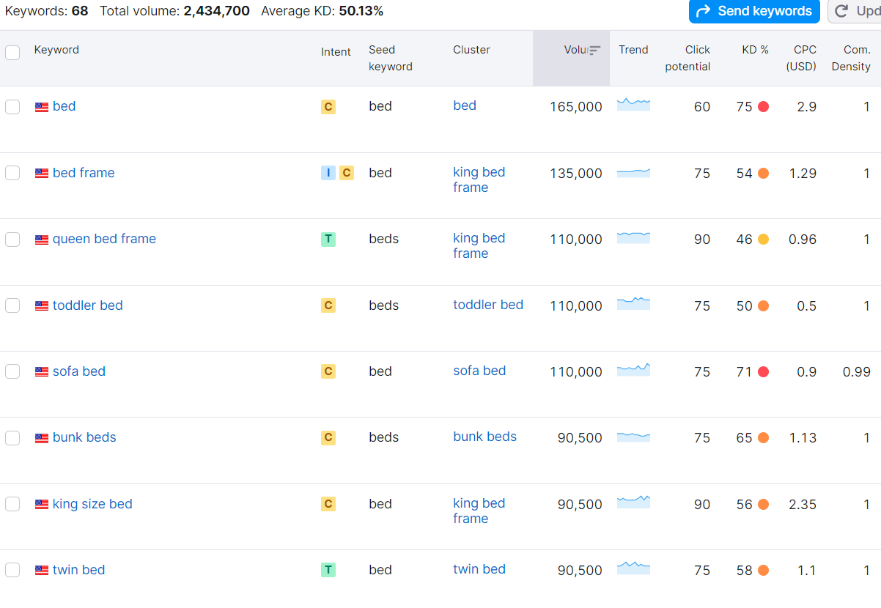
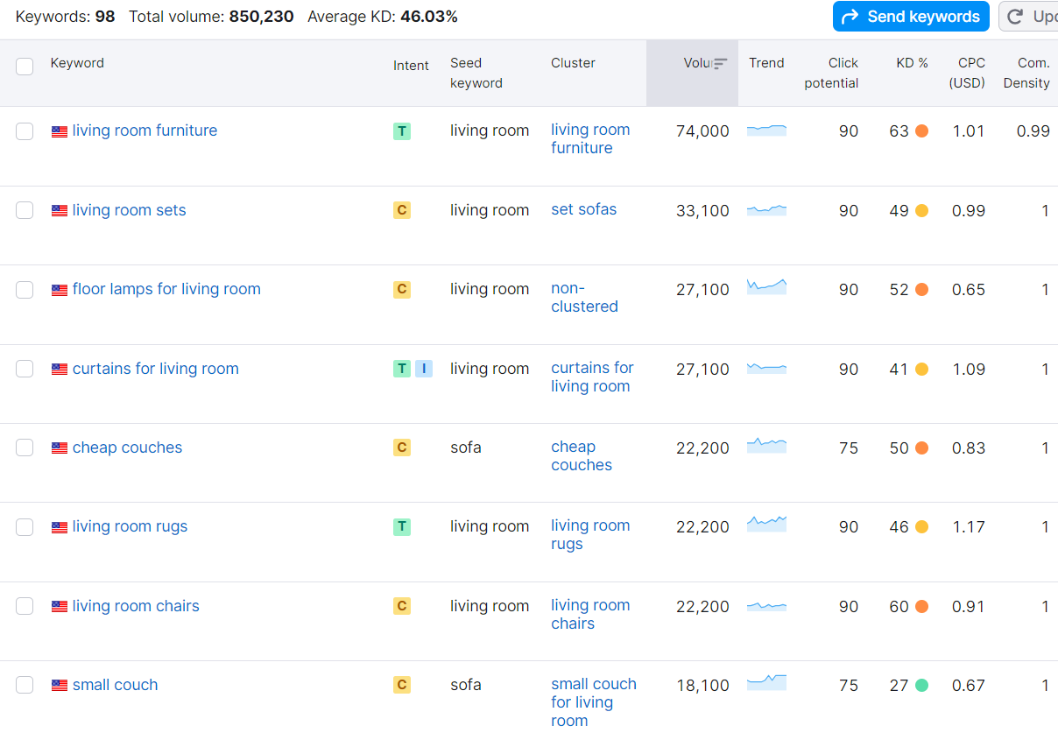
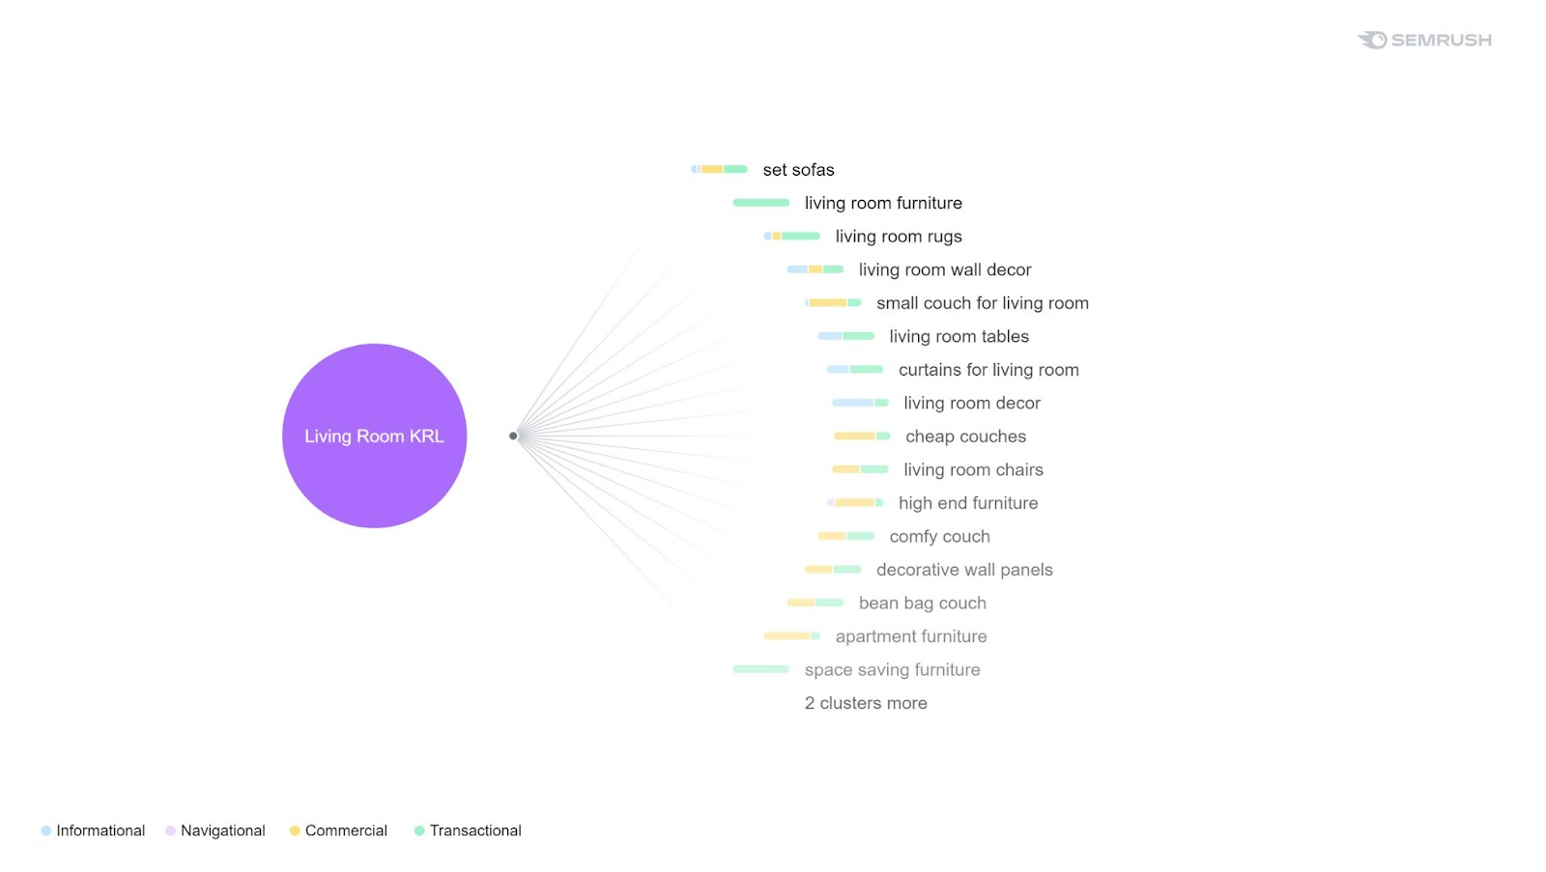
Notes:
GB

Slide 22
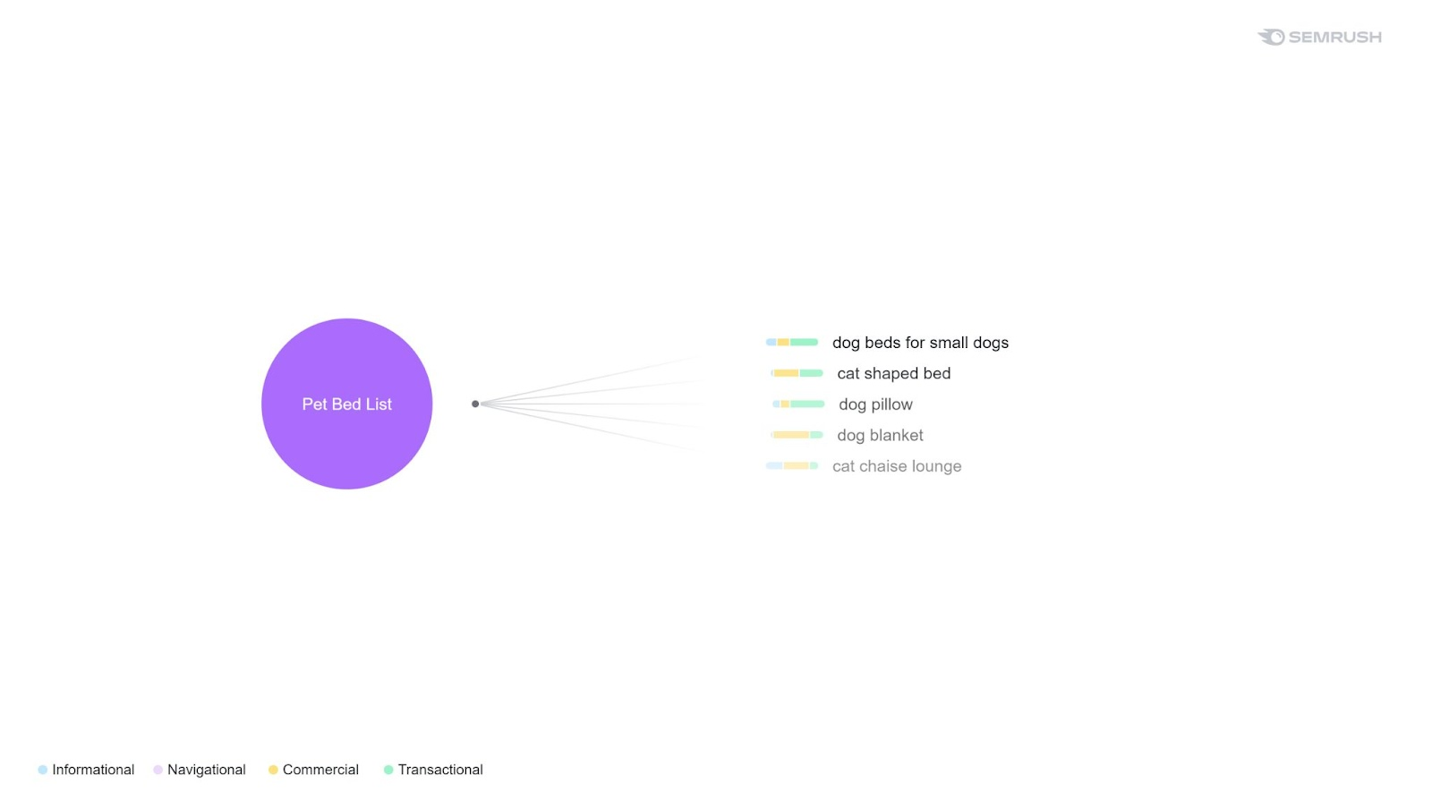
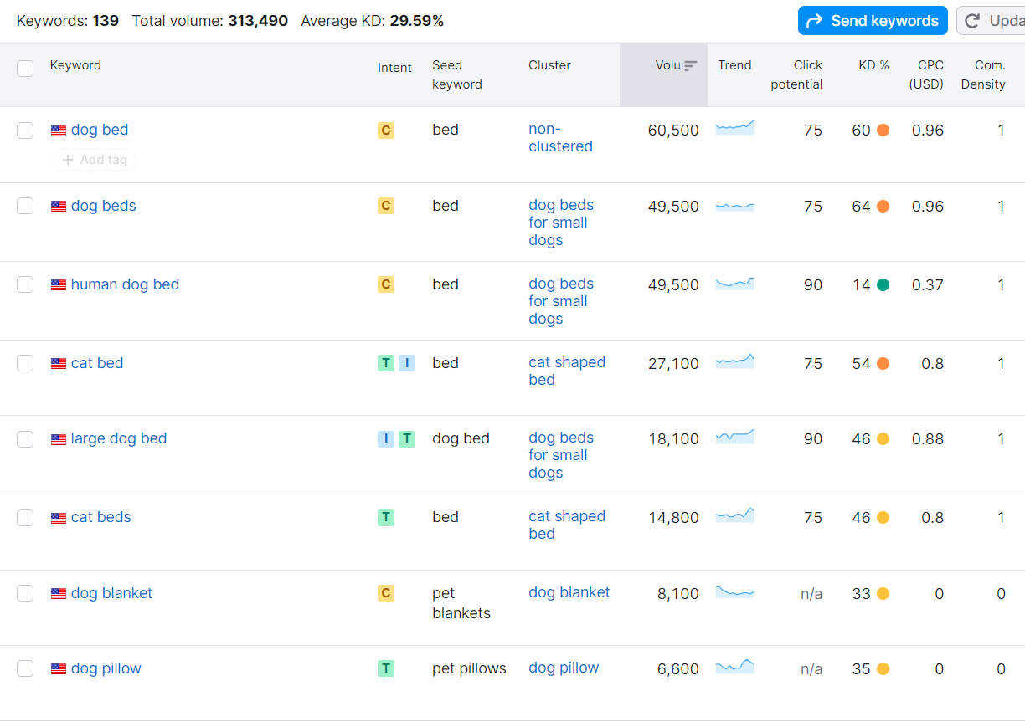
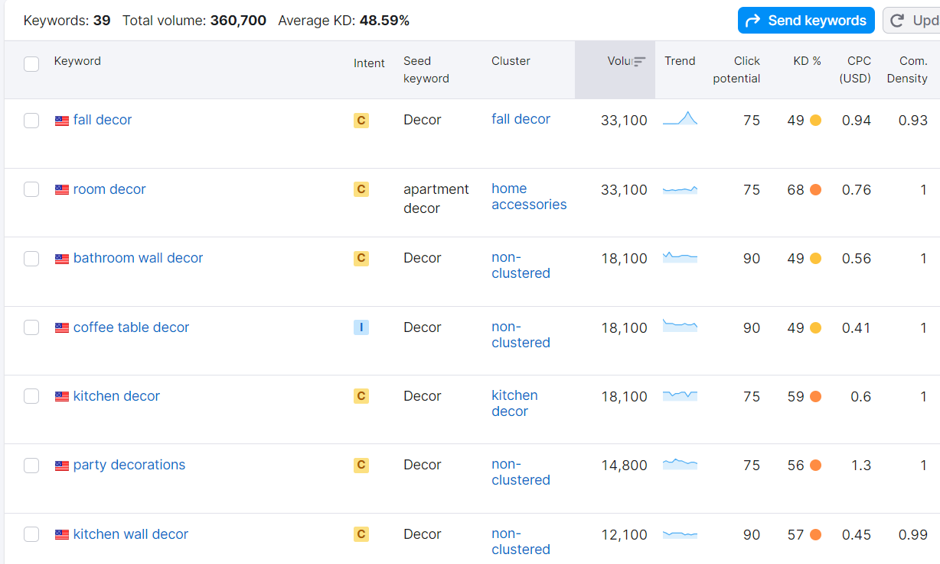
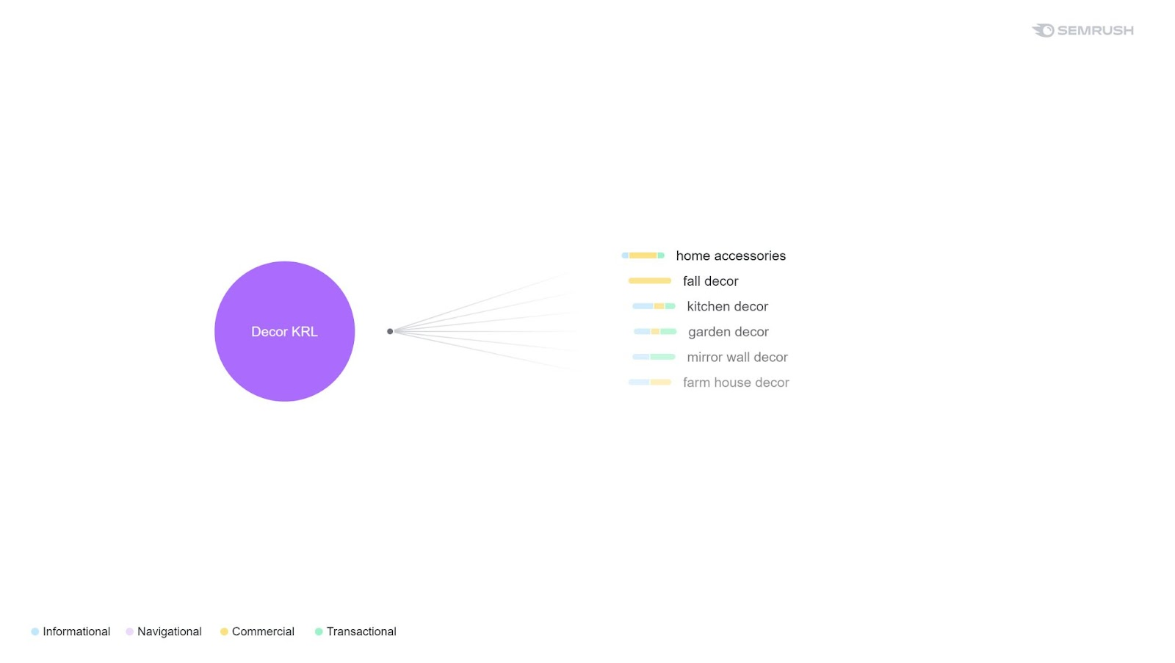
Notes:
GB

Slide 23
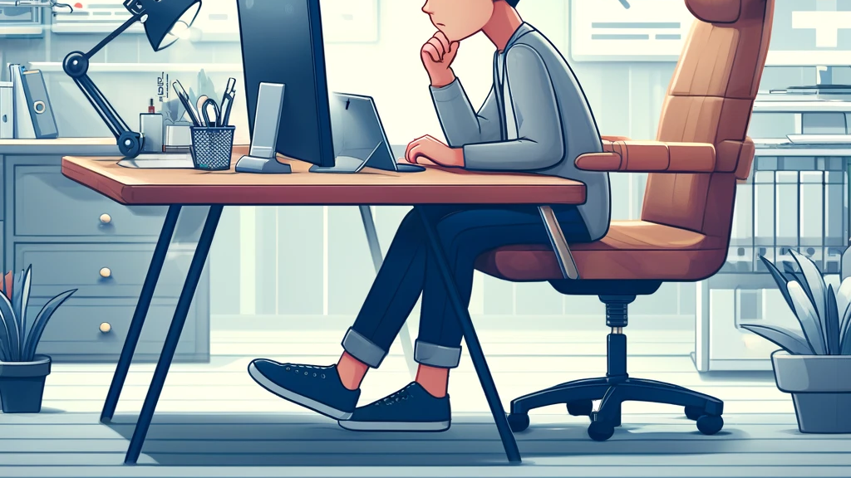
On-page seo strategies

Slide 24
Meta Tags
Meta Title: Wayfair | Home decor store, furniture, and more.
Meta Description: Explore Wayfair designs for any corner of your home. Any budget any style. Create an account today and enjoy free shipping on most items.
Homepage
Meta Title: Outdoorsy comfort for less | Enjoy your summer days with Wayfair.
○ Meta Description: Explore our variety of patio furniture and decorations for the hot days. Shop today and enjoy free shipping at Wayfair.
Category product page
○ Meta Title: Wayfair | Upgrade Your Outdoor Space with our table selection.
○ Meta Description: Discover top-quality outdoor table furniture on sale now! Upgrade your outdoor space with stylish and durable tables perfect for the open air.
Individual product page
24
Notes:
SA

Slide 25
Content Strategy
Utilize SEMrush's Topic Research tool to compile topic opportunities for content with a lower keyword difficulty. The goal is to provide insight and ideas to increase Wayfair’s traffic and backlinks through blog posts/articles.
Our content would follow a monthly schedule, publishing at least three times a month.
Notes:
VB

Slide 26
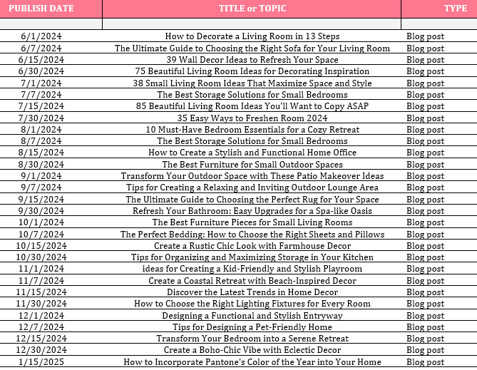
Notes:
EB

Slide 27

Off-page seo strategies

Slide 28
Outreach Strategies
EDITORIAL: Contact architectural digest
Launch of NEW COLLECTION submit photo collage.
Theme: Natural Beauty eco-chic “Going Green” renewable bamboo furniture.
PODCAST: Contact better homes
Free HOME DÉCOR SERVICE for first time customers.
Theme: Let us make your home “Picture Perfect”!
Offer home décor items to INTERIOR DESIGNERS to showcase their work.
Theme: “Before &After” photos with backlinks to product page.
Instagram: Nano influencer
TikTok: Influencer
Search for videos/ posts on how to assemble shelving, bunk beds, office furniture; contact.
Theme: “DYI Furniture Assembly”
Notes:
MM

Slide 29

Social Media Integration of Wayfair
Facebook
Use the platform to reach an audience who need furnishings in their homes/apartments and continue to advertise to them. Showcase new products and products that appeal to them through the usage of Meta’s marketing data that is integrated in Facebook and Facebook marketplace.
- Posting schedule for Facebook: Peak usage times are typical for Wayfair to post on Facebook. Wayfair’s posting schedule is early mornings, lunchtime, and evenings when people get out of work.
- Content theme for Facebook should be more of a relaxed style with nice pieces of furniture or home goods.
Notes:
EG

Slide 30

Social Media Integration of Wayfair
Instagram
Instagram is heavily media based and most people just scroll through all the pictures and short videos that are offered on the platform. Instagram has a great algorithm that helps its content be showcased to the respective customer that is most likely to make a purchase.
- Wayfair’s Instagram posting schedule is relatively similar to its Facebook posting schedule. Busiest times of the day are often the best times to post for media-based websites so that they are positive that they will have active engagement. Since Instagram is largely based on fast paced swiping. Multiple posts around the same time frames would be most beneficial to catch their customer base’s attention.
- Content theme for Instagram should be modern or futuristic. Something that catches the eye of the viewer as they scroll.
Notes:
EG

Slide 31

Social Media Integration of Wayfair
Twitter
Wayfair is a large company that has a massive amount of HomeGoods that are likely to receive backlash from customers. Twitter will allow Wayfair to answer customers immediately following their backlash or praise on the platform. This is beneficial to the company’s moralities and will make them look credible.
- Wayfair’s posting schedule is more customer dependent for Twitter. Twitter is mainly utilized for answering customers’ questions, comments, or concerns. Posting advertisements on Twitter would be most beneficial during peak customer engagement, just like Facebook and Instagram.
- Content theme for twitter should be simplistic furniture or home good items that are available with reviews being the main goal behind the post.
Notes:
EG

Slide 32

Social Media Integration of Wayfair
LinkedIn
Wayfair will use LinkedIn to promote their business ideology and improve their credibility. They will also be able to gain staff that has a much higher level of training and intelligence in their respective field. The utilization of LinkedIn allows Wayfair to overall benefit their company and target an audience who will keep their business running if they ever need to make staff replacements.
- Wayfair’s LinkedIn posting schedule for LinkedIn is largely during peak business hours when professionals are using this specific platform. As a business based social media, LinkedIn has peak hours during the work week. The most beneficial time for Wayfair to post would be during this opportunity of time.
- Content theme for LinkedIn should be more business related. Office equipment, desks, office supplies and chairs etc.
Notes:
EG

Slide 33
Notes:
Eric: STP
steph

Slide 34
THANK YOU
Mirjam Nilsson​
206-555-0146
mirjam@contoso.com
www.contoso.com

